Slide 1

Rating Prediction Project
By: Rakesh Chaudhary

Slide 2

Introduction:- Business Problem
We have a client who has a website where people write different reviews for technical products. Now they are adding a new feature to their website i.e. The reviewer will have to add stars(rating) as well with the review. The rating is out 5 stars and it only has 5 options available 1 star, 2 stars, 3 stars, 4 stars, 5 stars. Now they want to predict ratings for the reviews which were written in the past and they don’t have a rating. So, we have to build an application which can predict the rating by seeing the review.

Slide 3
Abstract :-
The purpose of this analysis is to make up a prediction model where we will be able to predict whether a recommendation is positive or negative. In this analysis, we will not focus on the Score, but only the positive/negative sentiment of the recommendation.
Sentiment analysis of product reviews, an application problem, has recently become very popular in text mining and computational linguistics research. Here, we want to study the correlation between the Amazon product reviews and the rating of the products given by the customers.
As online marketplaces have been popular during the past decades, the online sellers and merchants ask their purchasers to share their opinions about the products they have bought. As a result, millions of reviews are being generated daily which makes it difficult for a potential consumer to make a good decision on whether to buy the product. Analysing this enormous amount of opinions is also hard and time consuming for product manufacturers. This thesis considers the problem of classifying reviews by their overall semantic (positive or negative).

Slide 4
Steps to Follow:-
Data Collection
Loading Dataset
Pre-Processing
Data Analysis
Data Cleaning
Model Building
Hyper-Parameter Tuning
Conclusion

Slide 5


Data Collection:-
For this project, first of all we scrapped more than 50,000 records from different sites. And then build a model for predicting the overall rating from customers. We have used “Selenium Web scrapping” tool for scrapping the data form online ticket booking sites. Some sites are mentioned below:-

Slide 6
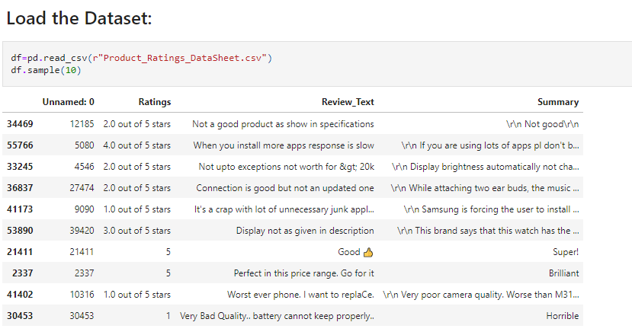
Loading the Dataset:-
Data contains attributes such as Ratings (which is the overall rating of the reviewer), Review Text (which contains all the thoughts of customer for that particular product), Summary (this attributes contains brief review by the customer), New review (which contains all the word count in the review text and summary), Review character count (this attribute contains all the character count of review text and summary attributes).

Slide 7
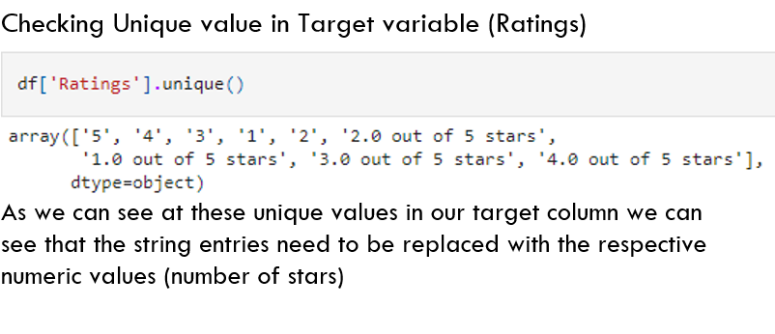
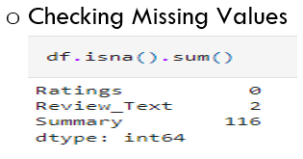
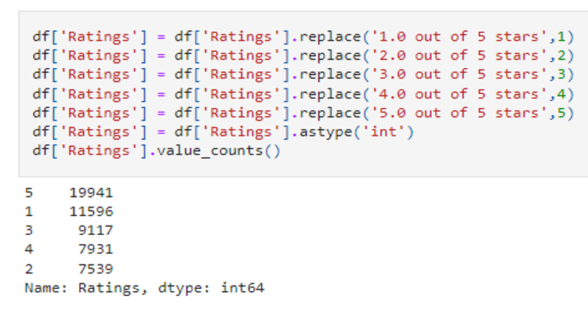
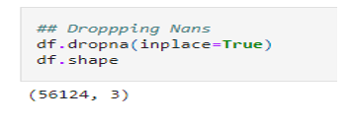
Data Pre-Processing:-

Slide 8

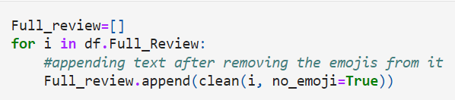
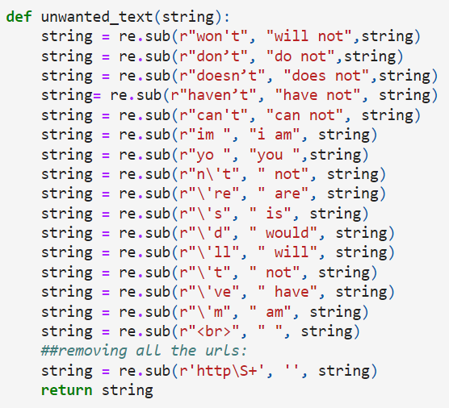
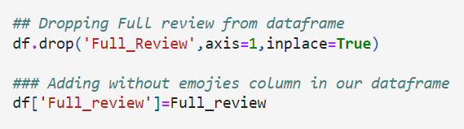
Data Pre-Processing:-
Replacing Contracted words

Slide 9

Data Pre-Processing:-
Lowercasing the Words:
DE contracted all the reviews :
Removing the Special Character :

Slide 10

Data Pre-Processing:-
Replacing Space key with Space:
Removing all the stop words:
Removing Unwanted Character & numbers:

Slide 11
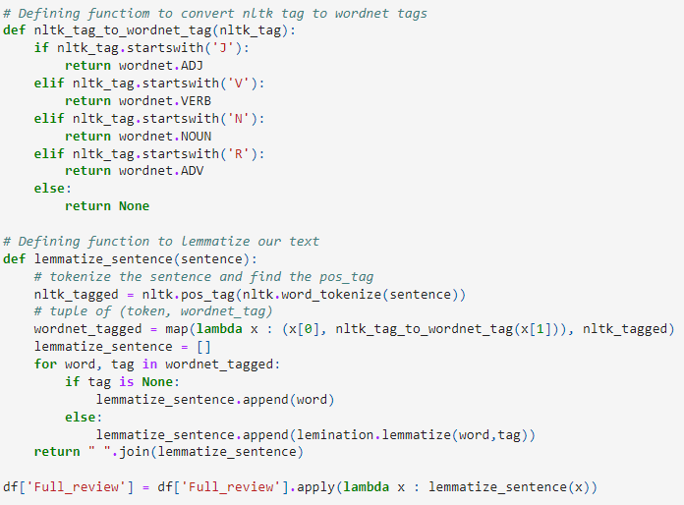
Lemmatization:-
Lemmatization usually refers to doing things properly with the use of a vocabulary and morphological analysis of words, normally aiming to remove inflectional endings only and to return the base or dictionary form of a word, which is known as the lemma.
Example: - Lemmatize minimizes text ambiguity. Example words like bicycle or bicycles are converted to base word bicycle. Basically, it will convert all words having the same meaning but different representation to their base form.

Slide 12
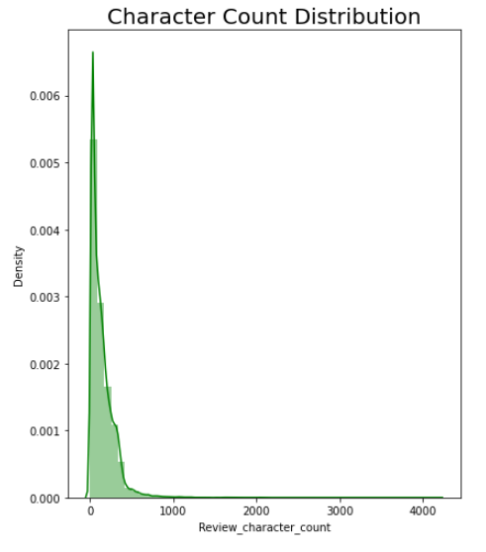
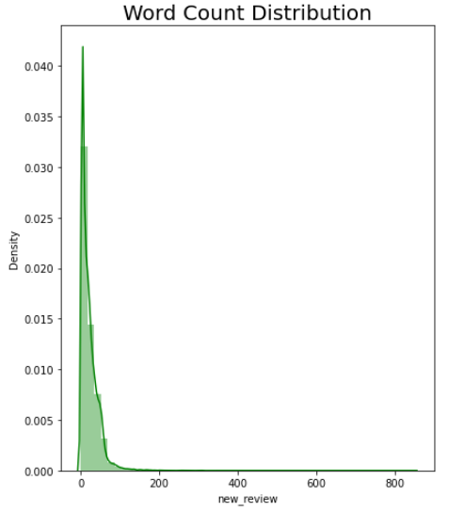
Data Analysis:-
As we can see that most of the words are accruing 0 to 10 times range.
Word counts is highly right skewed.
Above plot represents histogram for character count of review text, which is quite similar to the histogram of word count.

Slide 13
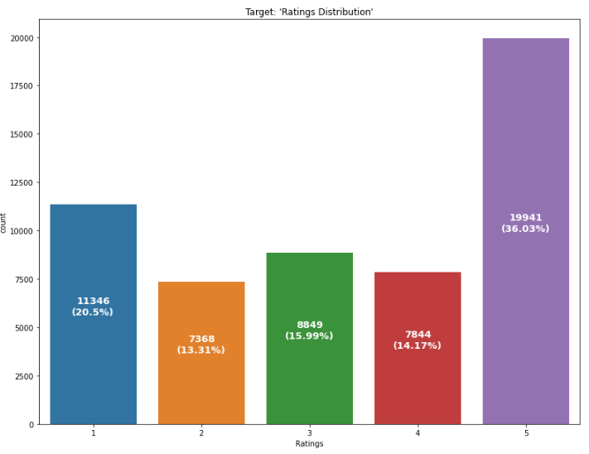
Data Analysis:-
As we can see that 5 Star rating received by most of the customers.
However we see a high 1 star rating as well compared to 2 and 3 star rating reviews.
But the count of 2 star and 3 star ratings received from customers is very low. so we have to handle it accordingly.

Slide 14
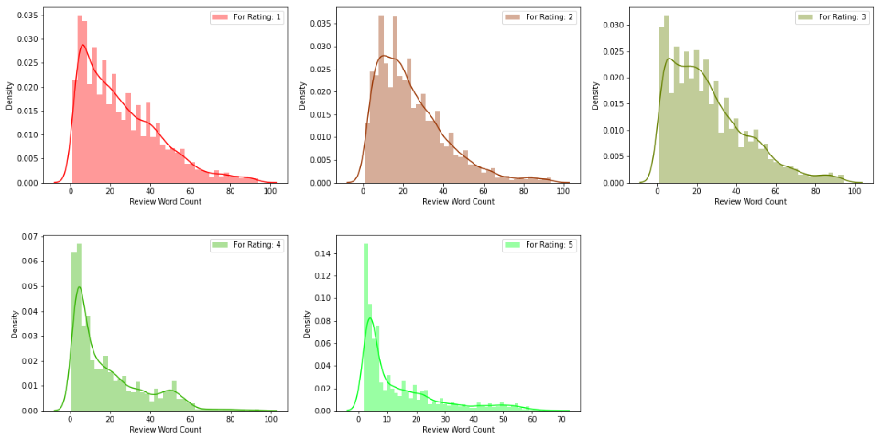
Data Analysis:-
We noticed that every type of ratings word count distribution is highly right skewed.
Also we see that most of the word count falling in the range of 0 to 10.

Slide 15
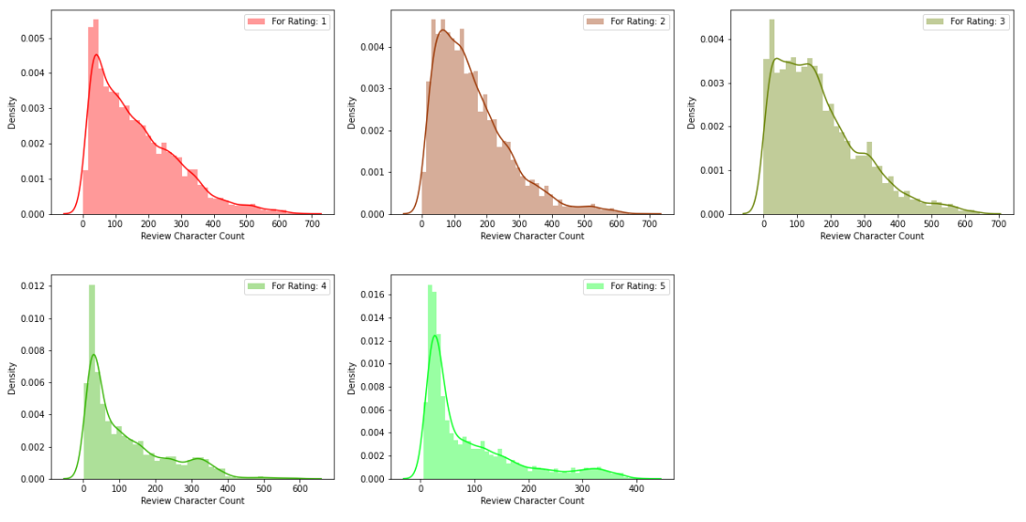
Data Analysis:-
We noticed that for every type rating, the character count distribution is highly right skewed.
Similarly most of character's count is falling in the range of 0 to 10.

Slide 16

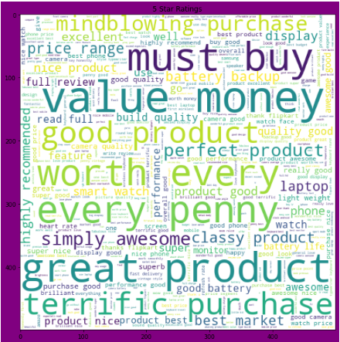


Data Analysis:-
5 Star Ratings
4 Star Ratings
3 Star Ratings

Slide 17
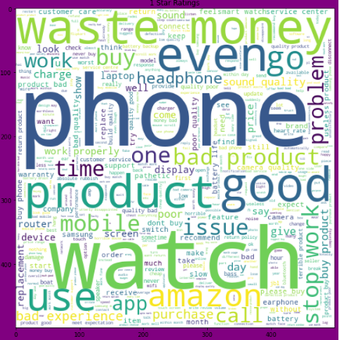
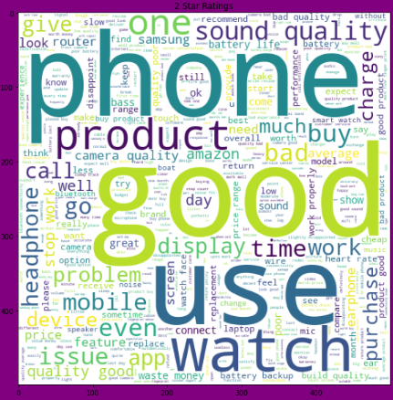
Data Analysis:-
1 Star Ratings
2 Star Ratings

Slide 18
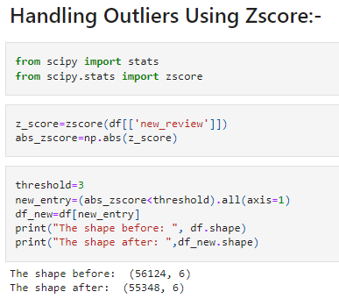
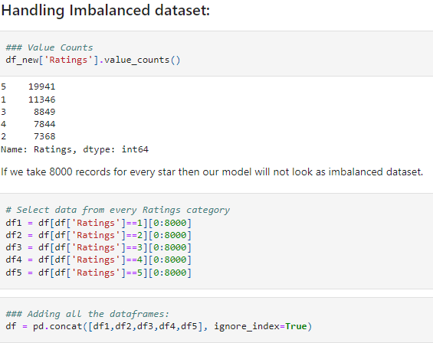
Data Pre-processing:-
Handling Outliers:-
Handling Imbalanced Data

Slide 19
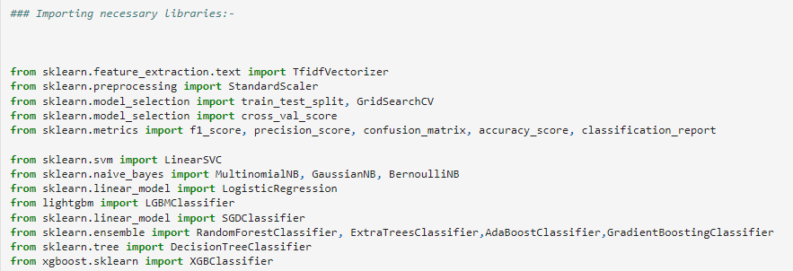
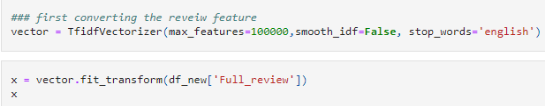
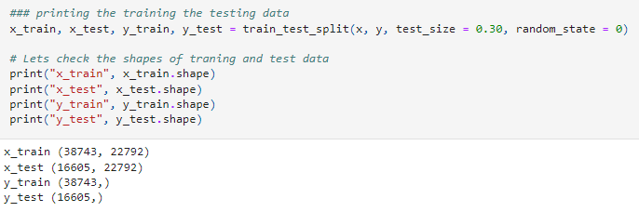
Model Building:-

Slide 20
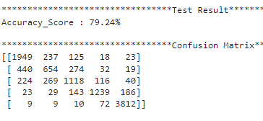
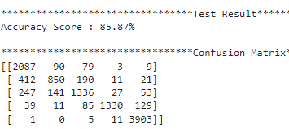
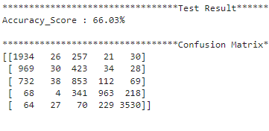
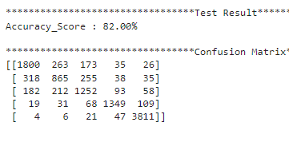
Model Building:- Printing Scores
* Logistic Regression:-
* Random Forest Classifier:-
* Ada Boost Classifier:-
* Decision Tree Classifier:-

Slide 21
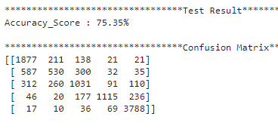
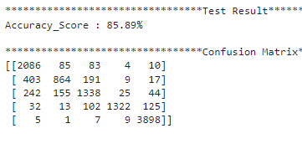
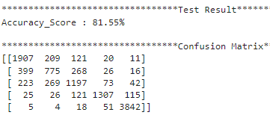
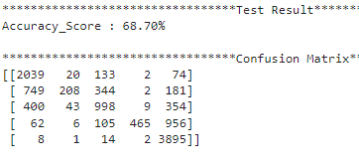
Model Building:- Printing Scores
* Gradient Boosting Classifier:-
* Extra Trees Classifier:-
* XG Boost Classifier:-
* Gaussian NB Classifier:-

Slide 22


Cross Validation:-
Logistic Regression
Decision Tree Classifier
Random forest Classifier
Ada Boost Classifier
Gradient Boosting Classifier
Extra Trees Classifier
XGBoost Classifier
Gaussian NB Classifier
LGBMC Classifier

Slide 23
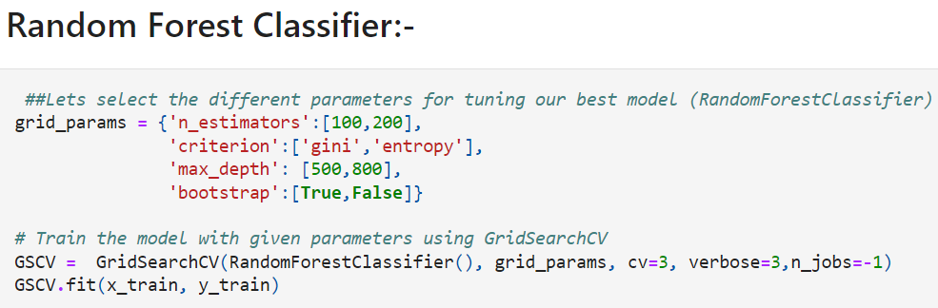

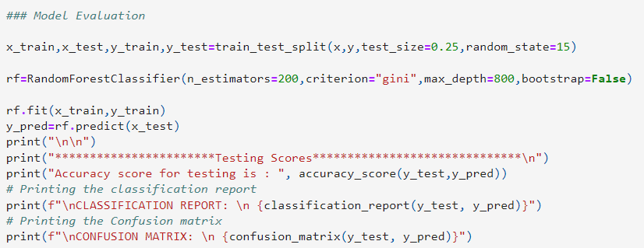
Hyper-Parameter Tuning:-

Slide 24
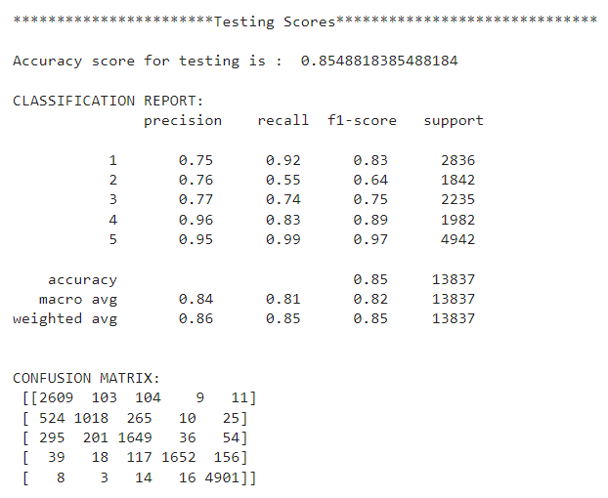
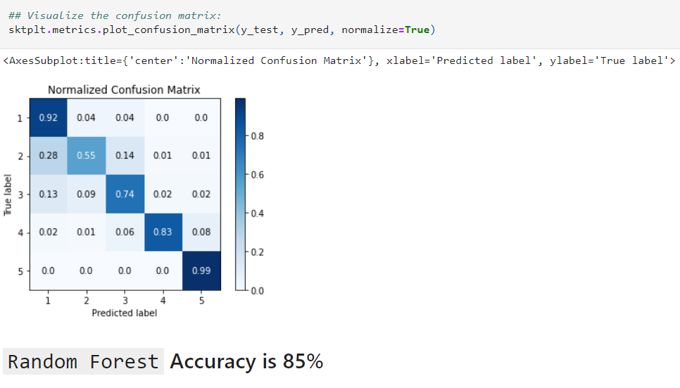
Model Evaluation:-

Slide 25

Conclusion:-
Challenges:-
Over Sampling
Class- imbalancing Problem
Local Machines incapable of handling computationally expensive calculation
Need a Helpful ratio challenges

Slide 26
Limitations of this work and Scope for Future Work-
One of the main reason our accuracy is not high enough is because of the data imbalance. We have given equal amount of class to our model for that we have to drop most of the data. This could be the reason of low accuracy. We will be looking into datasets obtained from E-commerce websites. This will provide better understanding of our sentiments based on demographics. And lastly we will try to work on this product to achieve a generalize form of this model.
For future we have to look into below mentioned points.
Try to fetch data from different websites. If data is from different websites, it will help our model to remove the effect of over fitting.
Try to fetch an equal number of reviews for each rating, for example if you are fetching 10000 reviews then all ratings 1,2,3,4,5 should be 2000. It will balance our data set.
Convert all the ratings to their round number, as there are only 5 options for rating i.e., 1, 2 ,3 ,4 ,5. If a rating is 4.5 convert it 5.

Slide 27


